Slide 1
DATABASE PROJECT Hotel Management System

Slide 2
Members:
Bilal Salman k15-2114
Bilal Shafique k15-2152
Muhammad Ahmed k15-2848
Hammad Aftab k15-2837

Slide 3
Hotel Casterly Rock:
The Hotel Management System has been designed for both the hotel management and the customers.
For a guest to avail the hotel facilities, for example, booking a room followed by a check in at a specific date and time. The task of maintaining the hotel rooms and the hotel services lies under the hotel management.
Automated version of the manual management system.
Consists of the booking management system, the DBMS, the generating of customer requests from the management perspective.
The report generator for every action that has been done.

Slide 4
Hotel Casterly Rock:
The main benefits of this management system is:
To ease customer access
Handle all the ongoing tasks in an effective manner unlike previous versions which used manual work and which are not efficient.
It makes sure of secure transactions and quick recovery of errors if there are any.

Slide 5
Hotel Casterly Rock:
The general functions of the project are as follows:
Customer:
Book a room
Reserve a room
Cancel a booking
Avail the hotel services
Check in
Check out
Management:
Adding the hotel rooms to the database
Adding the new customers to an existing database
Maintaining the hotel rooms and services
Reserve rooms for guests
Generating bills
Generating Payroll
Maintaining Dine-in Reservations

Slide 6
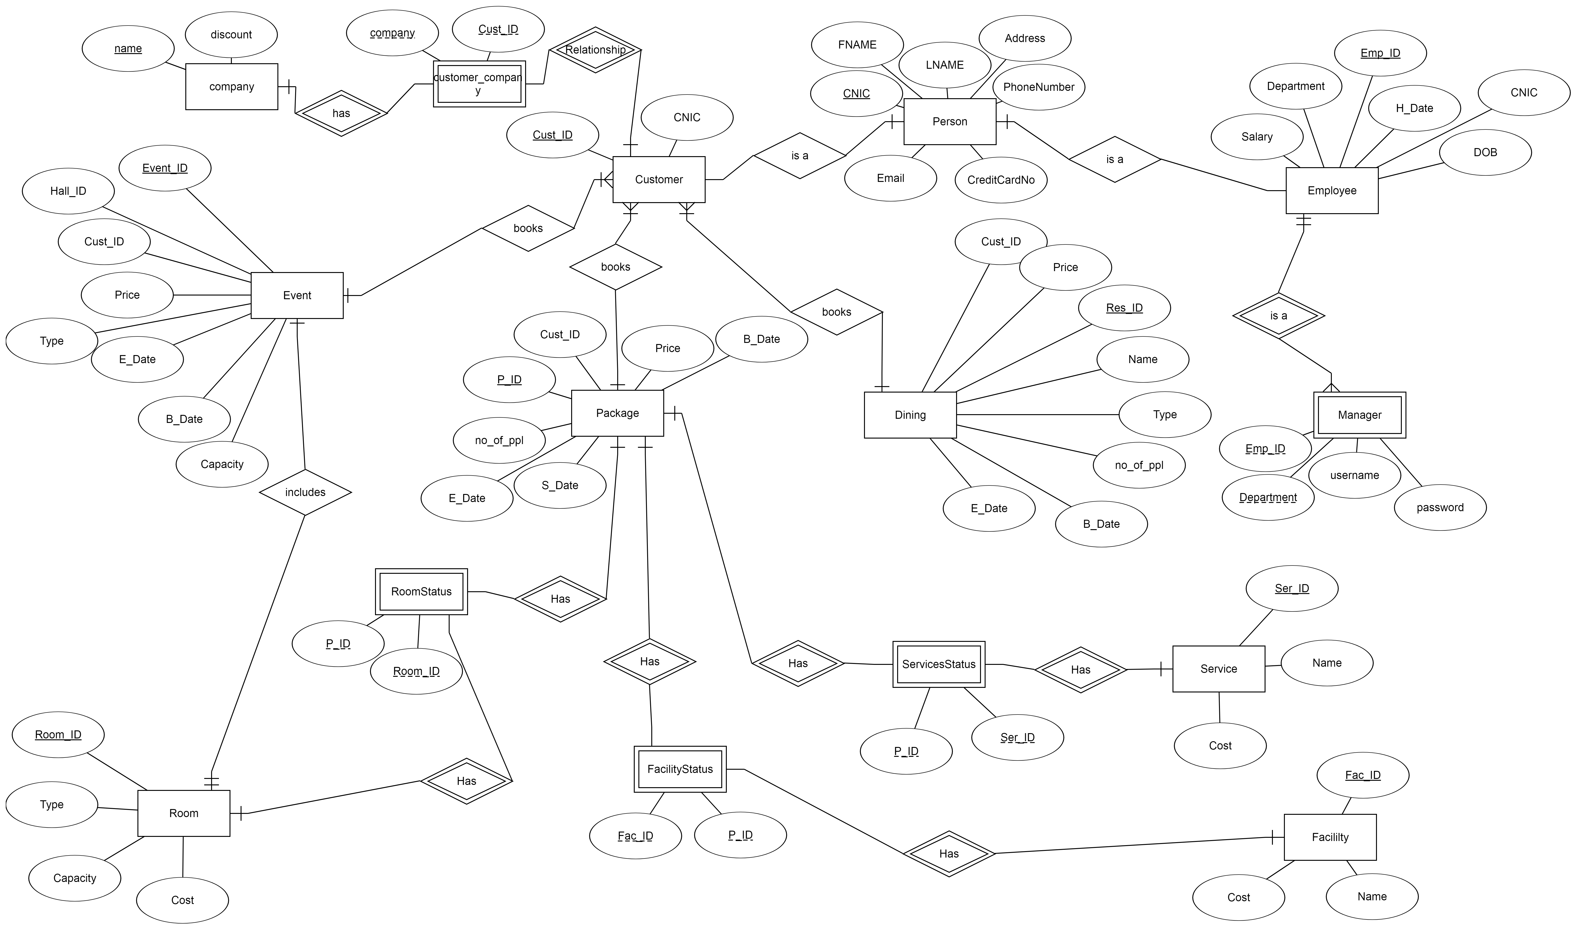

Slide 7
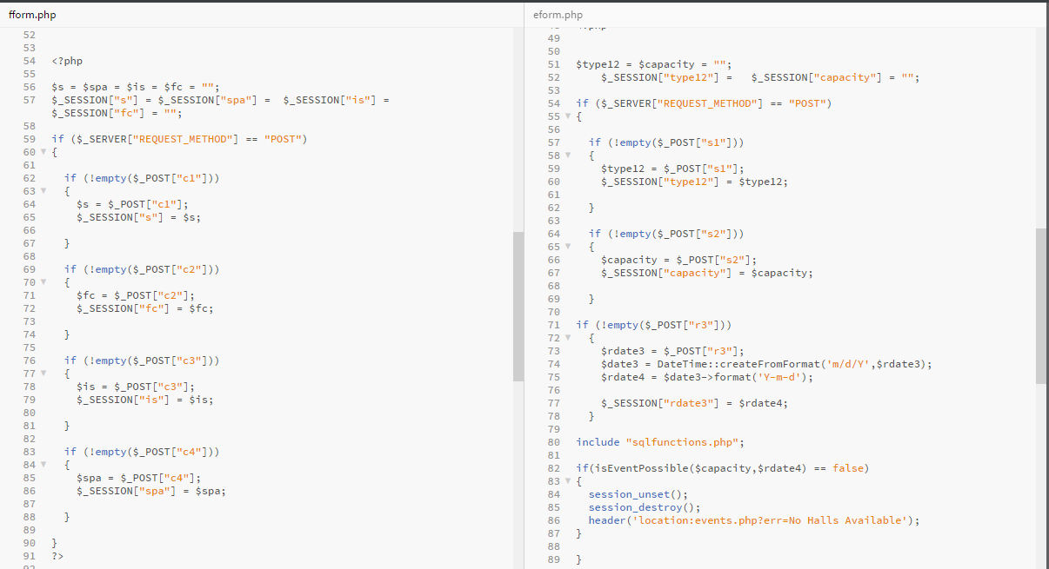
Facilities Form Events Form

Slide 8
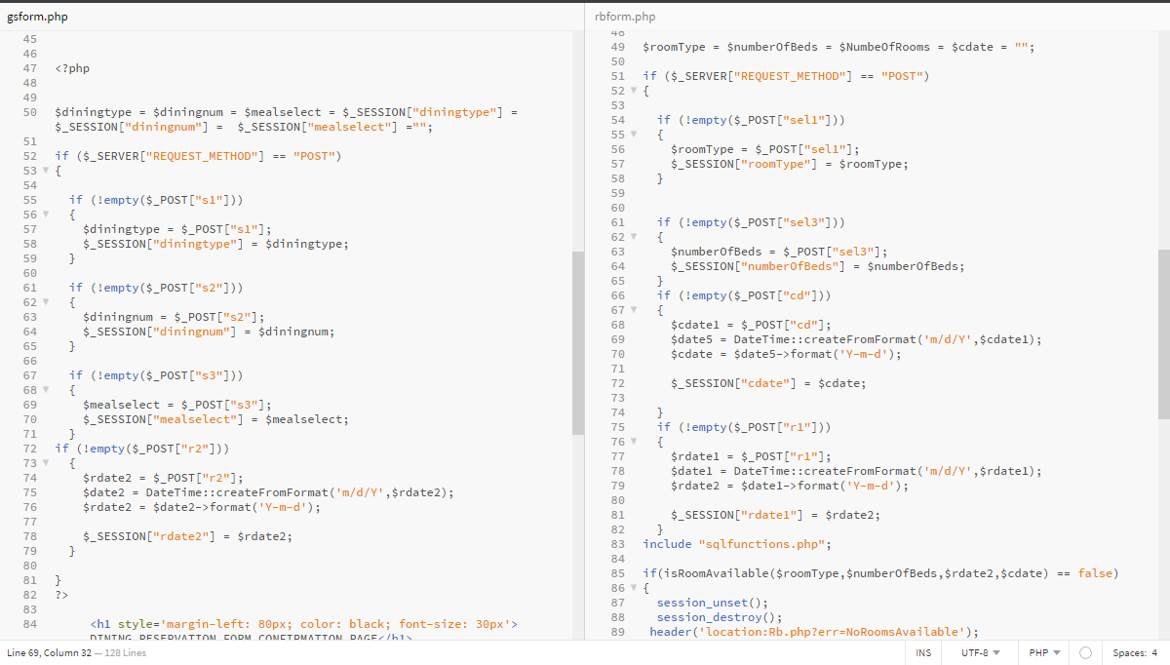
Gastronomy Form Room booking Form

Slide 9
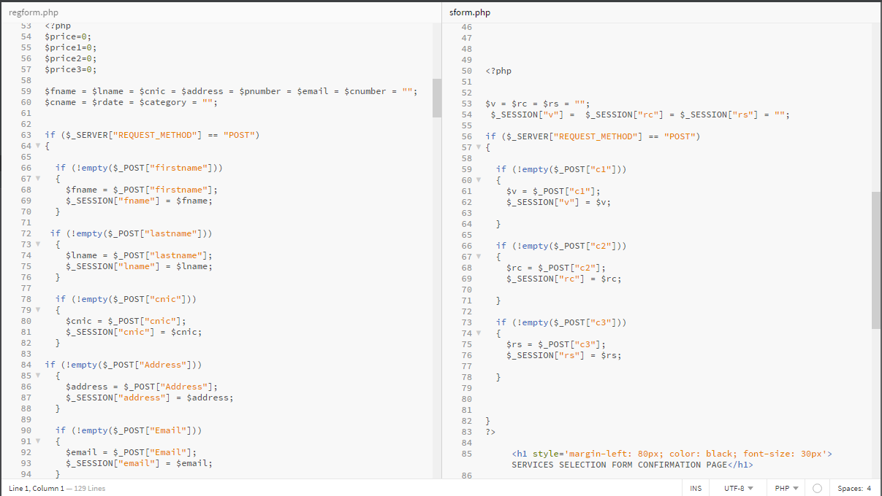
Registration Form Services Form

Slide 10
Task Division
Bilal Salman | Customer End;
Bilal Shafique | Customer End;
Muhammad Ahmed | Admin Panel;
Hammad Aftab | Admin Panel; Customer End.

Slide 11
THANK YOU!

